Slide 1
Alpaca
SONIC
Task 1
Task 1
for(i = 0; i < tile_size)
for(nv i = 0; i < rows)
Task 2
…
Task 2
…
50mf
1mf
1µf

Slide 2


Energy
Tile-5
Tile-12
SONIC
TAILS
a[0] += b[0] × c
a[0] += b[0] × c
a[0] += b[0] × c
a[0]
b[0]
…
…
…
…
+=
…
Vectorized
a[4] += b[4] × c
a[4] += b[4] × c
a[4] += b[4] × c
a[15]
b[15]
× c
a[5] += b[5] × c
…
…
a[16]
b[16]
Time
…
a[9] += b[9] × c
a[9] += b[9] × c
…
+=
…
× c
1s
a[7] += b[7] × c
…
Wasted Work
Loop Continuation
Recharging
a[5] += b[5] × c
a[0] += b[0] × c
a[9] += b[9] × c
a[16]
b[16]
…
…
…
…
+=
…
× c

Slide 3

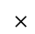
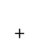

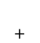

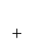
SONIC
1. Task_Convolve
FRAM
Loop Continuation: “unsafe” write after read
Loop index i = 1
Write Only
=
$$+$$
$$×$$
Read
Only
Loop index i = 2
i
=
$$+$$
$$×$$
2. Task_Next_Filter
Loop index i = 3
Swap Double Buffer
=
$$+$$
$$×$$
…
Next Filter Value
Loop-Ordered Buffering:
Idempotent

Slide 4
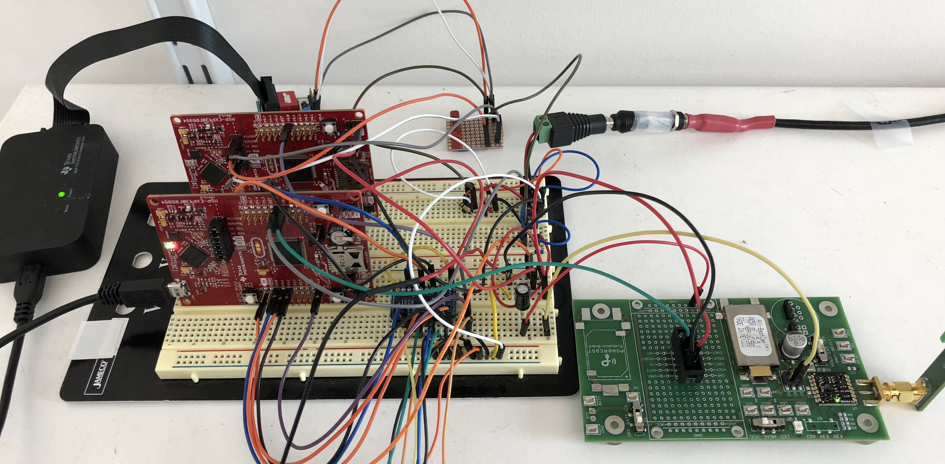


SONIC
TAILS
Relay & Regulator
MSP430 Application MCU
Powercast Harvester
Programming FET
Antenna
MSP430 Measurement MCU
Level Shifter
Energy storage capacitors

Slide 5
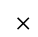
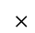
SONIC
Task_Convolve
Iteration index i = 1
FRAM
=
$$+$$
$$×$$
Iteration index i = 2
i
=
$$+$$
$$×$$
Loop Continuation: “unsafe” write after read
Iteration index i = 3
=
$$+$$
$$×$$
…
Write Only
Read Only
Loop-Ordered Buffering:
Idempotent
Task_Get_Next_Filter
Swap Double Buffer
Next Filter Value

Slide 6
TAILS
Task_Calibrating_Tile_Size
Tile Size 128
Energy-Aware Tiling
…
Power Failure
Tile Size 64
Tile Size 32
…

Slide 7


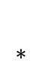
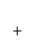
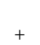

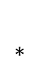
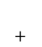
SONIC
TAILS
Task_Apply_Filter
Task_Calibrating_Tile_Size
Iteration index i = 1
FRAM
Tile Size 128
Energy-Aware Tiling
=
$$+$$
$$×$$
…
Iteration index i = 2
i
Power Failure
=
$$+$$
$$×$$
Loop Continuation: “unsafe” write after read
Tile Size 64
Tile Size 32
Iteration index i = 3
…
=
$$+$$
$$×$$
Write Only
…
Task_Apply_Filter
Read Only
Loop Continuation: “unsafe” write after read
Iteration index i = 1
$$∗$$
Loop-Ordered Buffering:
Idempotent
Task_Get_Next_Filter
=
$$+$$
LEA
FRAM
Iteration index i = 1
$$∗$$
Swap Double Buffer
DMA
=
$$+$$
LEA
i
Iteration index i = 1
$$∗$$
=
$$+$$
LEA
Next Filter Value
…
Write Only
Read Only
Write Only
Read Only
Loop-Ordered Buffering:
Idempotent
Task_Get_Next_Filter
Swap Double Buffer
Next Filter Value

Slide 8
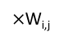
SONIC
TAILS
Apply Filter
Calibrating Tile Size
Iteration 1
FRAM
Iteration 2
Calibrated
Tile Size
Iteration 3
Power Failures
+=
$×$W_{i,j}
Apply Filter
…
FRAM
DMA
LEA VRAM
Swap, Next Filter
<Low energy Accelerator (LEA)>
Swap
LEA VRAM
FRAM
Next Applicable
Filter Value
DMA
Swap, Next Filter
Swap
Next Applicable
Filter Row

Slide 9
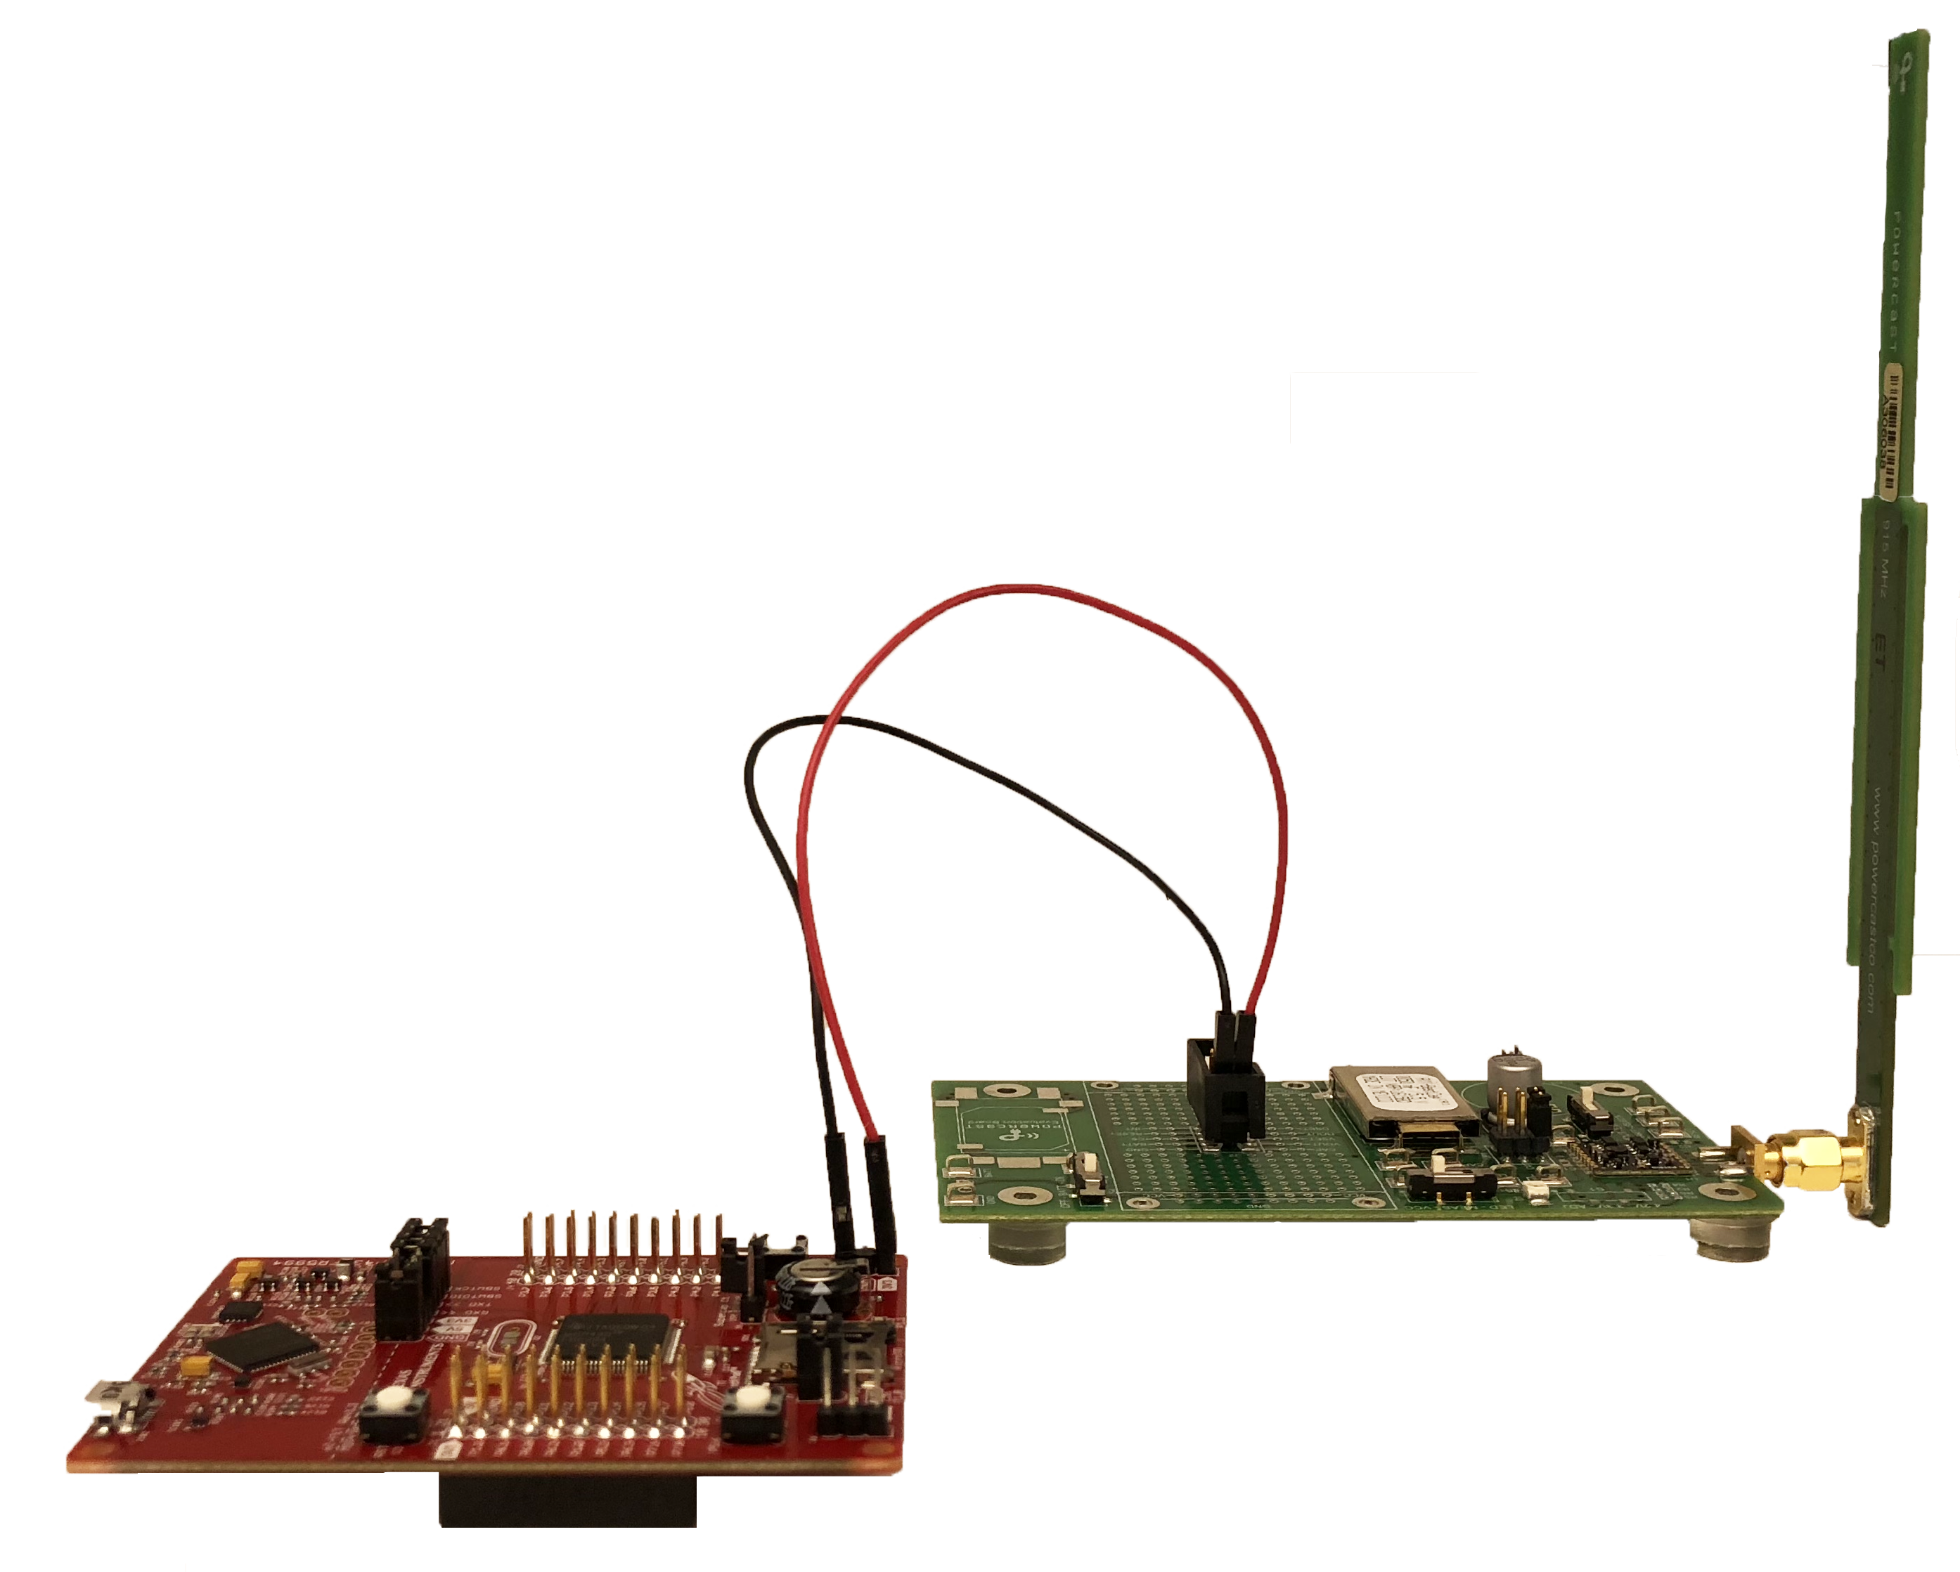

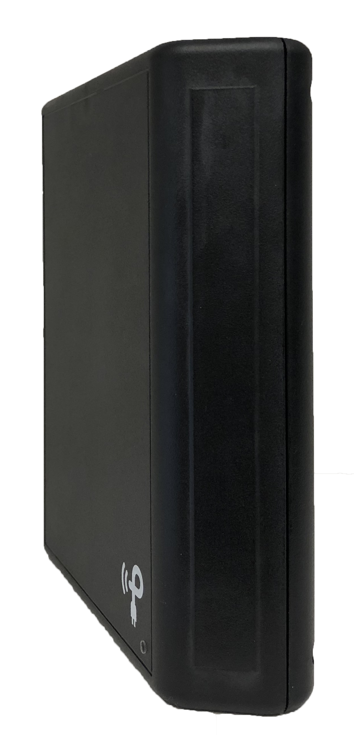

TAILS
SONIC
Radio Waves
Powercast
1m
Transmitter
MSP430

Slide 10
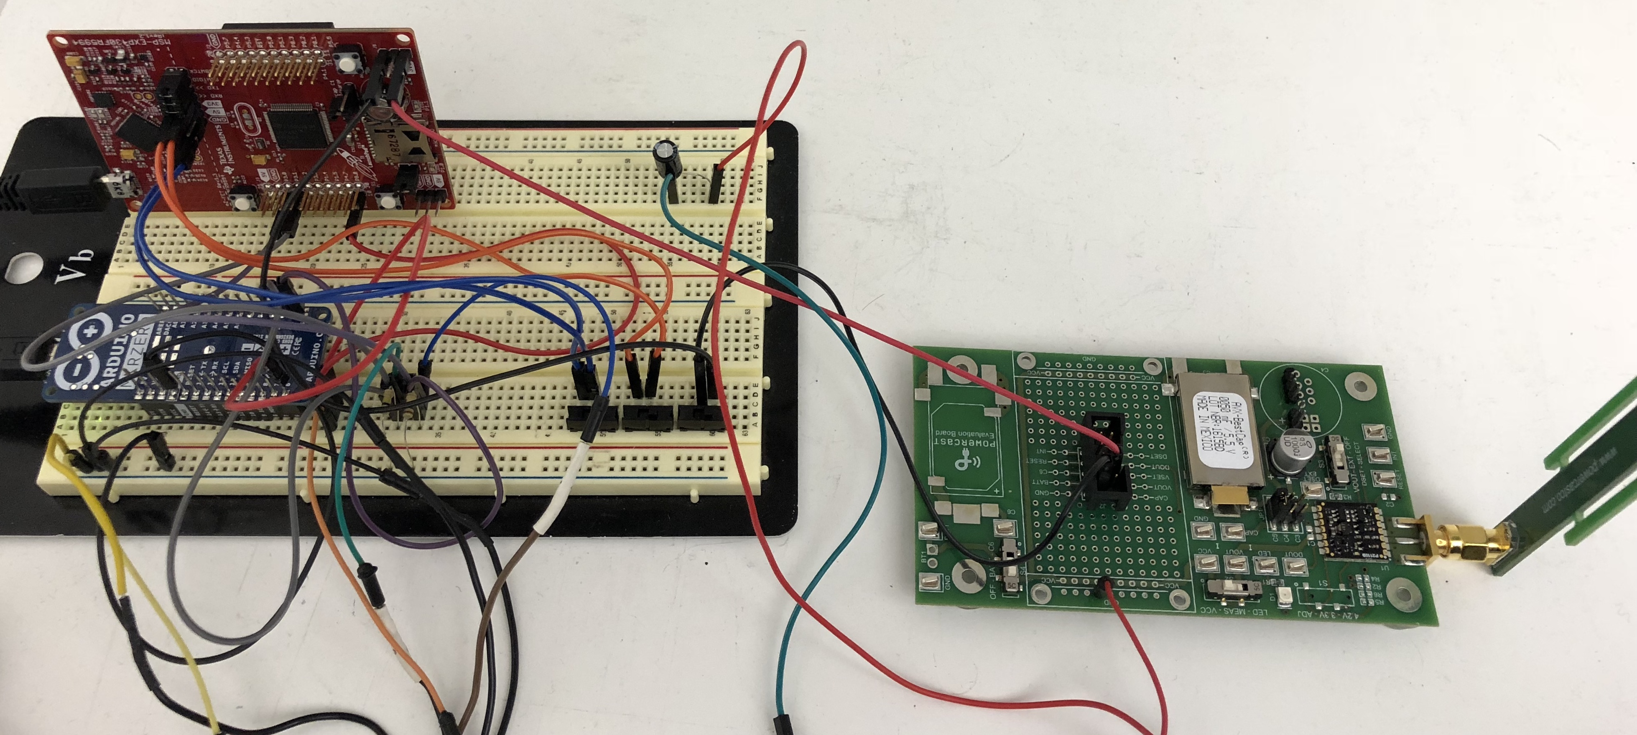
SONIC
TAILS
TI MSP430 Application MCU
Powercast Harvester
Antenna
Measurement MCU
Energy storage capacitors

Slide 11


App
NN
BLAS
Network Specification
1
SONIC
TAILS
1
task_s_conv
task_sm_conv
task_calibrate
1
Initialize
mac_length = last_length / 2
MAC(inter1, inter2)
tile_size^{nv} = mac_length
task_s_conv
i^{nv} = 0
j^{nv} = 0
pos^{nv} = 0
Energy-aware tiling
…
task_sm_conv
1
task_ds_add
task_sm_conv
Loop Continuation
Apply Filter
Initialize
2
for(i^{nv} ; i^{nv} < rows; i^{nv} ++)
for(j^{nv} ; j^{nv} < cols; j^{nv} ++)
w = inter1[i^{nv}][j^{nv}]
w += activitations[i^{nv}][j^{nv}] * f
inter2[i^{nv}][j^{nv}] = w
i^{nv} = 0
pos^{nv} = 0
2
task_pool
or
task_pool
task_pool
…
Loop-ordered Buffering
Apply Filter
3
Get Next Filter
for(i^{nv} ; i^{nv} < rows; i^{nv} ++)
DMA_Load(inter1)
w = FIR_DCT(inter1, f )
DMA_Store(w, inter2)
3
task_relu
pos^{nv} ++
f = filter[pos^{nv}]
inter1, inter2 = inter1, inter2
task_relu
task_relu
…
…
Get Next Filter
…
pos^{nv}++
f = filter[pos^{nv}]
inter1, inter2 = inter1, inter2

Slide 12
SONIC
TAILS
task_sm_conv
task_calibrate
task_s_conv
Task: Initialize
mac_length = last_length / 2
FIR_DTC(y1, y2)
tile_size = mac_length
i = 0
j = 0
pos = 0
Energy-aware Tiling
Loop Continuation
task_sm_conv
Task: Apply Filter
Task: Initialize
for(i; i < rows; i++)
for(j; j < cols; j++)
t = y1[i][j]
t += x[i][j] * w
y2[i][j] = t
i = 0
pos = 0
Task: Apply Filter
Task: Get Next Filter
Loop-ordered
Buffering
for(i; i < rows; i++)
DMA_Load(y1)
t = FIR_DTC(y1, w )
DMA_Store(t, y2)
pos++
f = filter[pos]
y1, y2 = y2, y1
Bold = nonvolatile
memory
Task: Get Next Filter
pos++
w = filter[pos]
y1, y2 = y2, y1

Slide 13
GENESIS
SONIC API
In
Conv
Compile
FC
ReLU
Deploy
w/ LEA
Link w/ TAILS
HW Accel. Lib.
Deploy w/out LEA

